Slide 1
UNVEILING MARKET INSIGHTS: Analysing Spending Behaviour and Identifying opportunities for Growth
Government Arts college
Karur
FACULTY MENTOR
K.KALPANA M.SC.,B.ED

Slide 2
TEAM MEMBERS
M. Anbarasi (Team Leader)
P. Aarthi (Team Member)
T. Abirami (Team Member)
S. Anusuya (Team Member)

Slide 3
INTRODUCTION
wholesaling or distributing is the sale of goods to retailer to industrial, commercial, institutional or other professional businessman to other wholesalers and related subordinated services.
The marketing tactic used to increase sales by advertising a product before it’s released.

Slide 4
Purpose
In today’s highly competitive business landscape, gaining deep market insights is essential for businesses to thrive and grow.
This project aims to analyze customer spending behaviour and identify opportunities for growth by leveraging data analytics and data-driven decision-making.

Slide 5
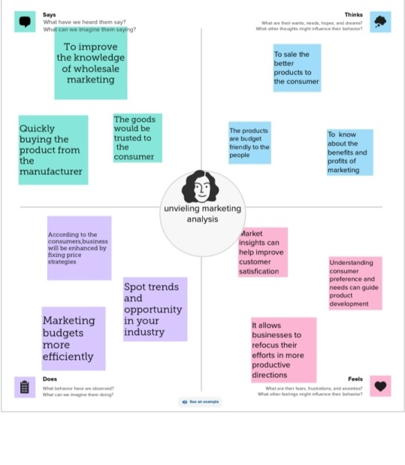
Empathy map

Slide 6
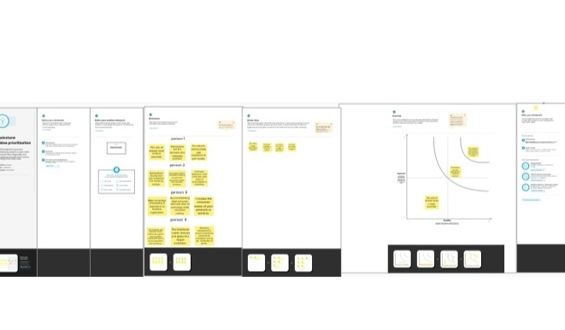
Brainstorm

Slide 7
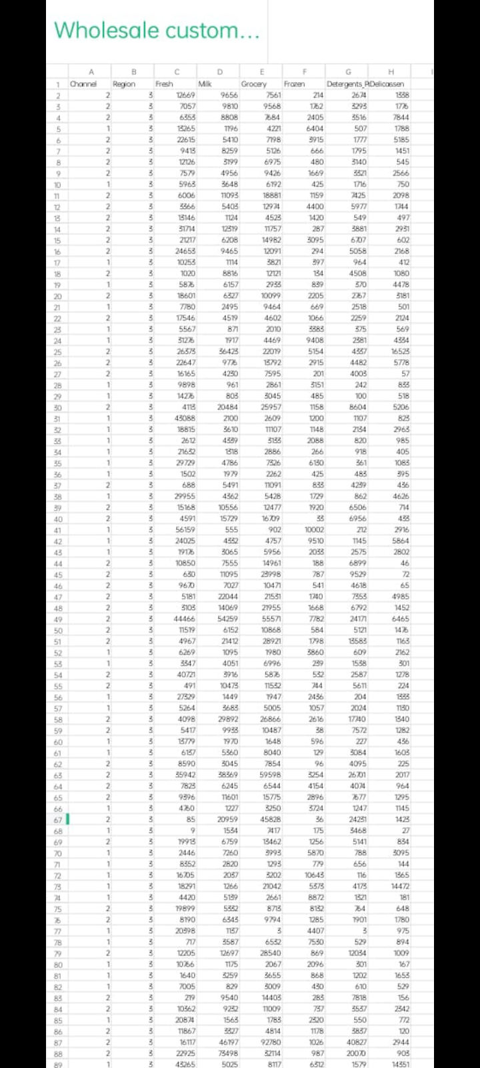
DATA SET

Slide 8
ABOUT DATASET
milk – the product sold by the wholesale customers.
Detergent paper- the product sold by the wholesale customers.
grocery – the product sold by the wholesale customers.
delegation – the process of distributing and entrusting work to another person.

Slide 9
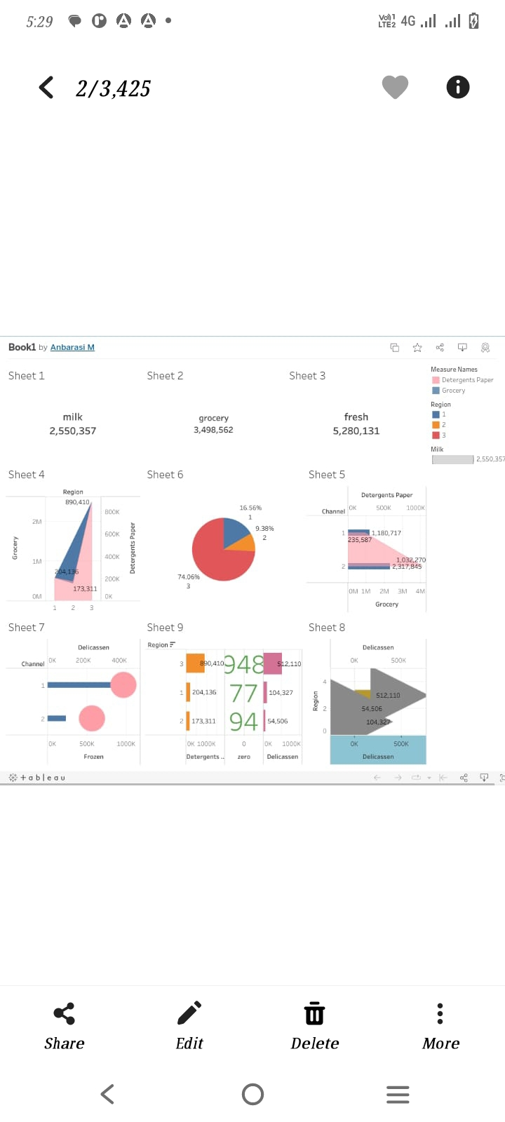
DASHBOARD

Slide 10
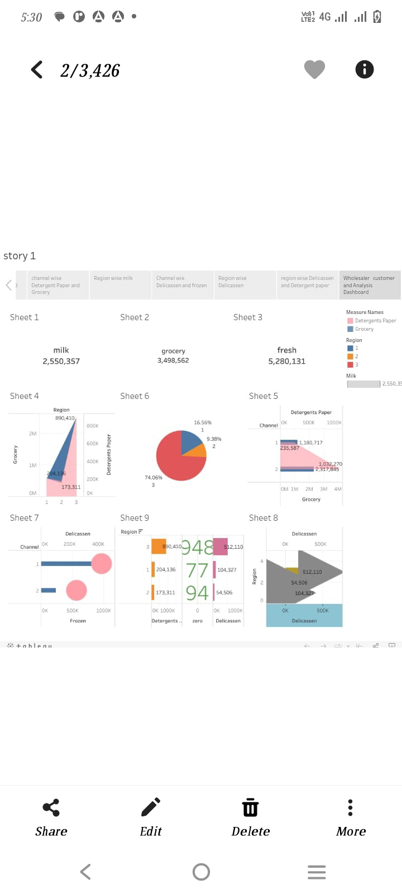
STORY

Slide 11
ADVANTAGES
The creation and propagation of a brand.
get to know the business.
Diversification.
Make a profit.
Access to the product.
Create a supply chain.
They are no more schlepping in wholesale.
Whole removes the requirement for unsold goods in stock.

Slide 12
DISADVANTAGES
Market analysis can be expensive.
Market analysis can be time-consuming.
Market analysis can require extra staff.
Market analysis can be narrow.

Slide 13
conclusion
A wholesaler must have a license to sell to a retailer, and his goods and are typically not offered to customers at the same price as they are to the retailer.

Slide 14
FUTURE HOPE
This process helps businesses understand customer needs, tailor their products or services, and improve marketing strategies and also ultimately enhancing customer satisfication and loyalty.

